Slide 1

n Ontario
CAPSTONE PROJECT
EBroadband Technologies in Elementary and Secondary Schools in Southwestern Ontario
External Stakeholder-Connecting Windsor Essex(CW-E)
Data Analytics for Business-GROUP 10

Slide 2







About Team
Anil Kakkar
Gagandeep Kaur Heera
Kartik
Kanishka Singh
Vijay Khanna

Slide 3


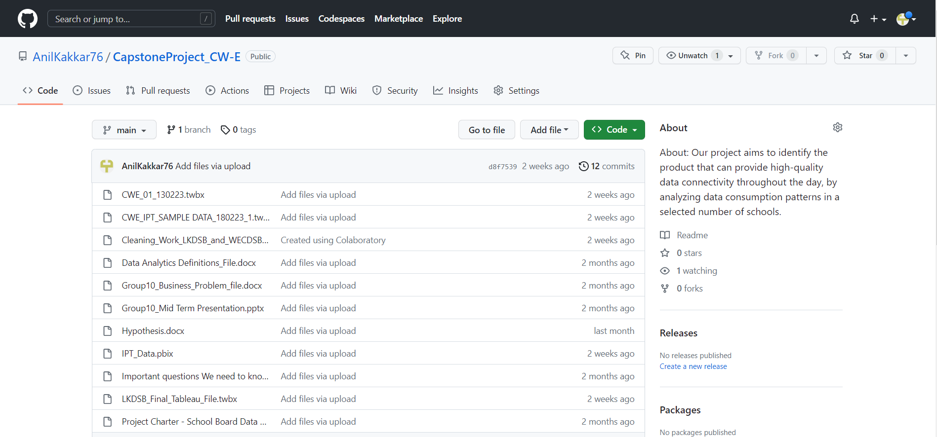

https://github.com/AnilKakkar76/CapstoneProject_CW-E
Git HUB
LINK and Overview

Slide 4






About CW-E
1.
Connecting Windsor-Essex is a non-profit organization consisting of a Board of Directors, a Board Executive, and over 40 member companies and organizations in Windsor-Essex.
2.
The organization is funded by stakeholder groups, including local governments, educational institutions, and healthcare providers.
3.
The initial focus of the organization was to build a high-speed fiber optic network for leading institutions in the region, but it has since expanded to provide services for businesses and residents, particularly in rural areas

Slide 5






AGENDA
UNDERSTANDING, PLANNING, RELATED WORK
MODEL AND APPLICATION
DATA PREPARATION & CHALLENGES
BUSINESS PROBLEM
KEY FINDINGS AND INSIGHTS

Slide 6





Goals and objectives
Analysis of Broadband Quality.
Analysis of Broadband Speed
Comparison between Carriers at the same Location
Comparison between Different Technologies
Analysis of external factors (i.e., Weather) on the internet services.
Comparison of internet usage between High and Elementary Schools

Slide 7


Hypothesis
Download & Upload speeds depends upon/related to values of Ping & Jitter
Broadband Quality parameters depends upon/related to ISP’s/Carriers.
Broadband Quality parameters such as Download & Upload speed, Ping & Jitter depends upon/related to Weather Conditions.
Broadband Quality parameters such as Download & Upload speed, Ping & Jitter depends upon/related to Number of Users & Number/Types of Applications being used.
Broadband Quality parameters depends upon/related to technology being used for data delivery(Fibre optics/Coaxial Cables/Cellular) ..

Slide 8



DATA COLLECTION AND PREPARATION
Feb 27
result-IPT
This data set includes information about the bandwidth server and related technology from February 8th to February 15th, 2023.
WECDSB Windsor Essex Catholic District School Board
This data set contains information collected from September 2022 to February 2023, and it includes data from four high schools and four elementary schools that are part of the WECDSB.
March 20
Lambton Kent District School Board LKDSB
The data set consists of information collected over a period of five months from eight different high and elementary schools within the LKDSB.

Slide 9









CHALLENGE
WECDSB
4 HIGH SCHOOLS
HOW DO WE REDUCE FILES
48 Worksheets
BIGGEST CHALLENGE
FIND RELATION
EACH FILE Contain
4 ELEMENTARY SCHOOLS
SCHOOL ID
3 Worksheets
6 Worksheets

Slide 10









CHALLENGE
LKDSB
Each Folder Contain 1 month of Data of 8 Schools
IN total 4 per School
4
8 = 32
Each School Contain
32 files of DATA Each Month
5 months of Data
32
5 = 160
BIGEST CHALLENGE FOR US
160 Files in TOTAL
END RESULT
Clean and prepare it for analysis.
Find ways to combine and reduce it
Time management as we have less time and more work
4 Files in TOTAL AFTER CLEANING AND MERGING

Slide 11



ANALYSIS OF BROADBAND QUALITY AND SPEED
Quality is directly proportional to Bandwidth and inversely proportional to Network Congestion.
ELEMENTARY SCHOOLS
HIGH SCHOOLS
Secondary schools typically have higher internet and device usage compared to elementary schools.
In general, the rate of transmitted and received packets is higher in secondary schools and lower in elementary schools
62%
85%
Let’s Jump Into Tableau Dashboards for better Understanding
LKDSB
&
WECDSB
LKDSB
&
WECDSB

Slide 12


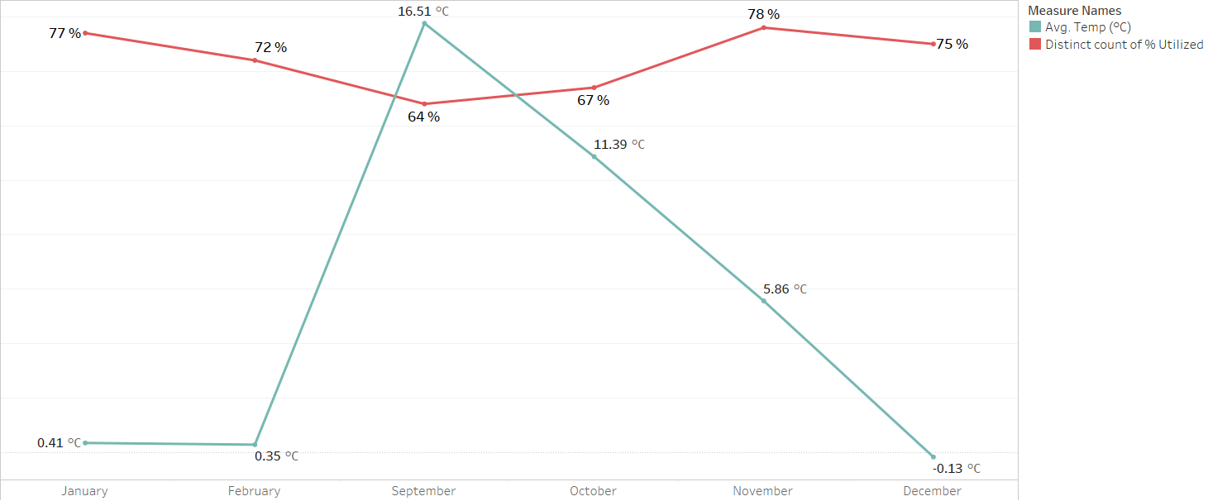



Analysis of external factors
(i.e., Weather) on the internet services
AVG of Device utilization in %
AVG Temperature in °C

Slide 13
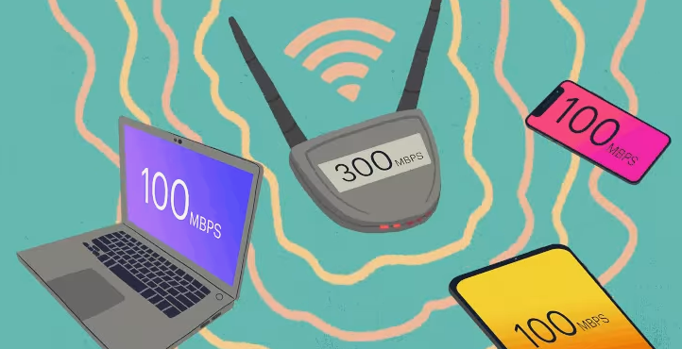



Slide 14
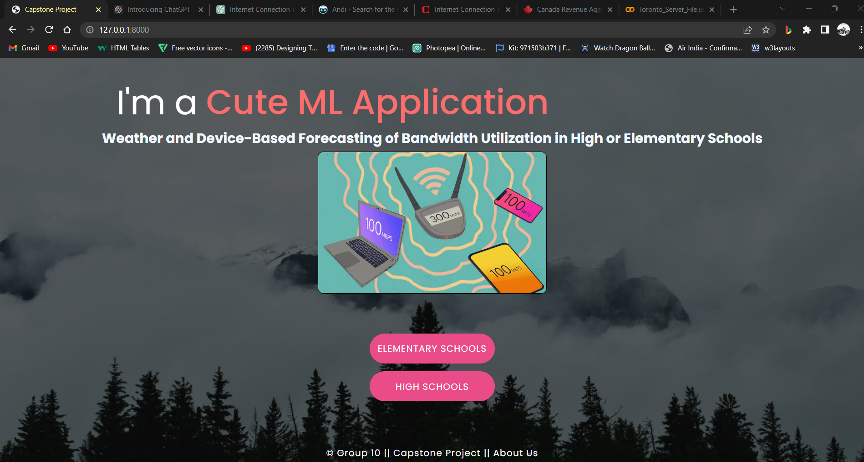

Let’s Directly Jump Into the Cute ML Application

Slide 15

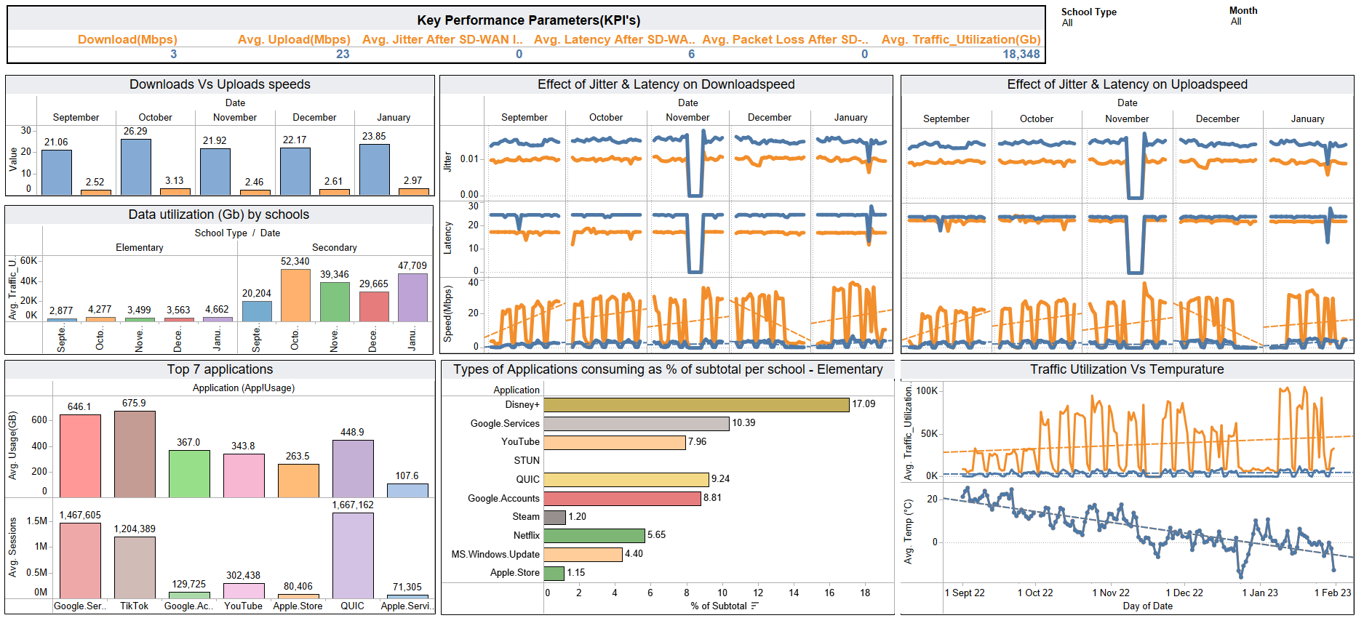
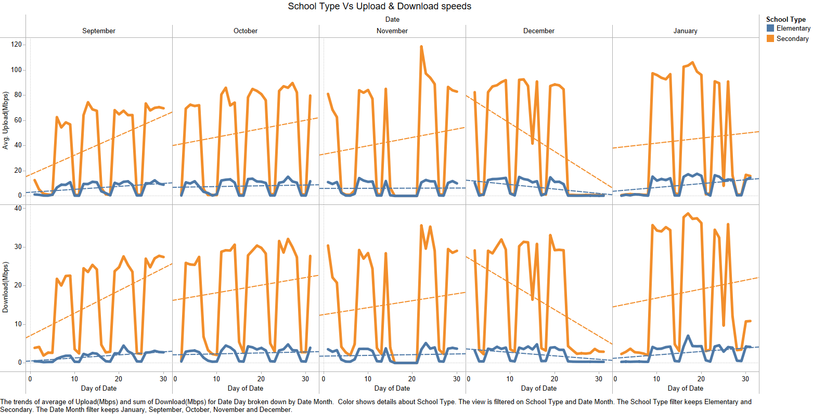




INSIGHTS What Our Data Speaks….
1.Higher speeds & Data utilization in High/Secondary schools.
2.Good Quality of service parameters

Slide 16

3.Uploads > Downloads.
4.Latency & Jitter are higher for Elementary schools.

Slide 17
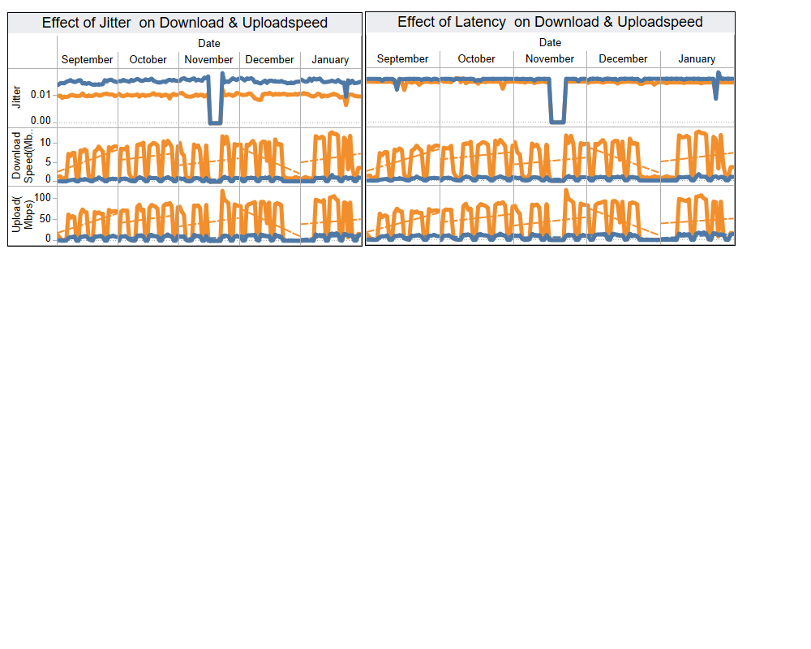

5. Download & Upload speeds have no relation to Latency, Jitter and Weather.
6. Devices being utilized are related to weather.

Slide 18
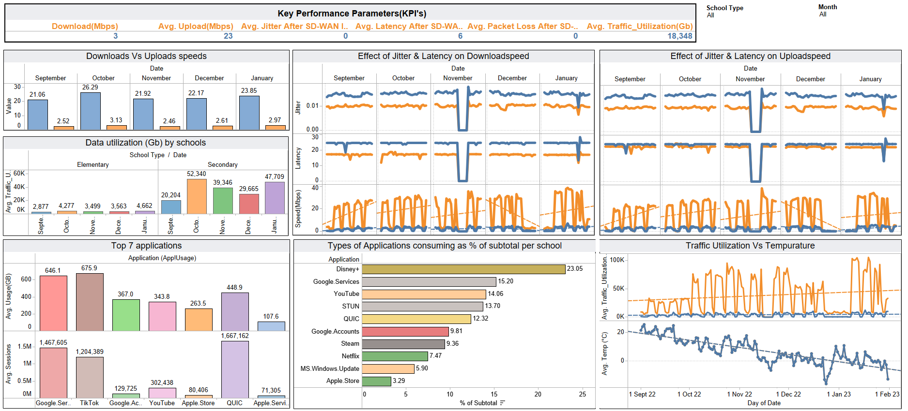
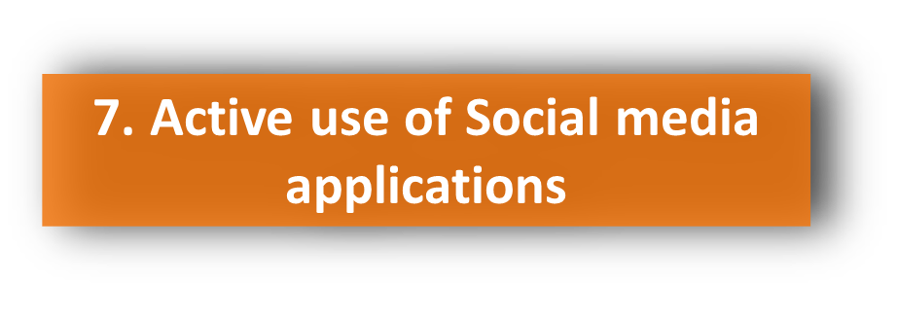



Slide 19
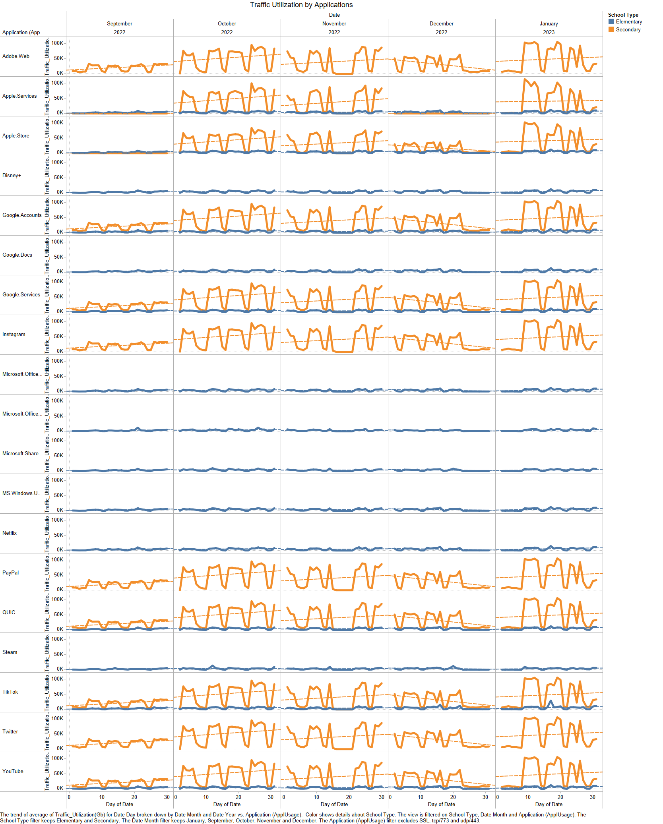
Some Common Applications

Slide 20
RECOMMENDATIONS
Proper Traffic management in Elementary Schools
Implement ways to reduce data usage by some applications i.e, Google advertising ,STEAM & Tik Tok
Negotiation for better pricing from ISP’s
Implementation of SD WAN

Slide 21




THANK YOU
FEEL FREE TO ASK ANY QUESTIONS
#STUN:An IETF protocol for real-time voice, video and messaging in an IP network. STUN provides the mechanism to communicate with users behind a network address translation (NAT) firewall, which keeps their IP addresses private within the local network (LAN).
#QUIC : An alternative to TCP/IP protocol. QUIC is a new general-purpose, secured multiplexed transport-layer network protocol. QUIC incorporates a number of TCP-like properties, as well as TLS encryption, layering them within the application space on top of a UDP transport. By the middle of 2021, QUIC accounted for 12% of internet traffic. 30% of YouTube traffic has already transitioned to QUIC. Facebook was the next site to switch, and it has already migrated over 75% of its traffic to QUIC.

